Slide 1
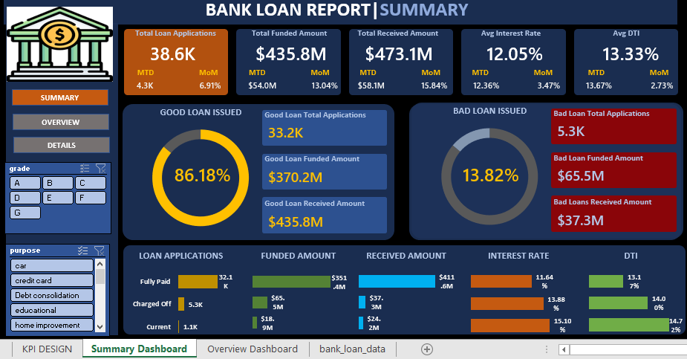
MS EXCEL DASHBOARD

Slide 2
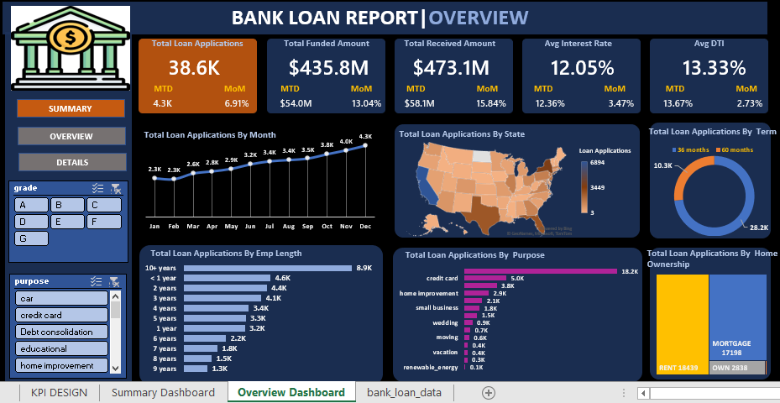
MS EXCEL DASHBOARD

Slide 3
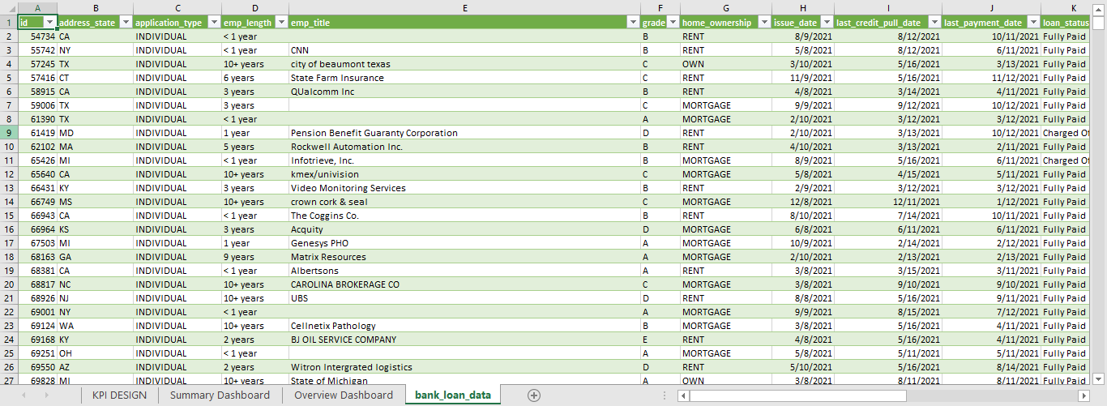
MS EXCEL DASHBOARD

Slide 4
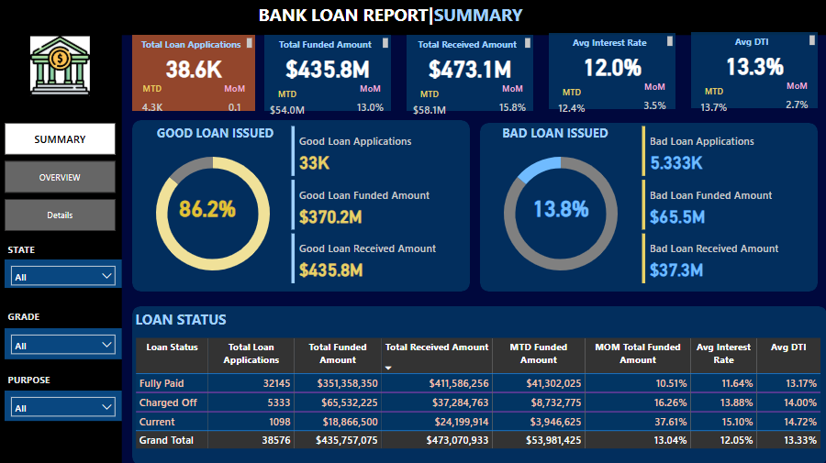
POWER BI DASHBOARD

Slide 5
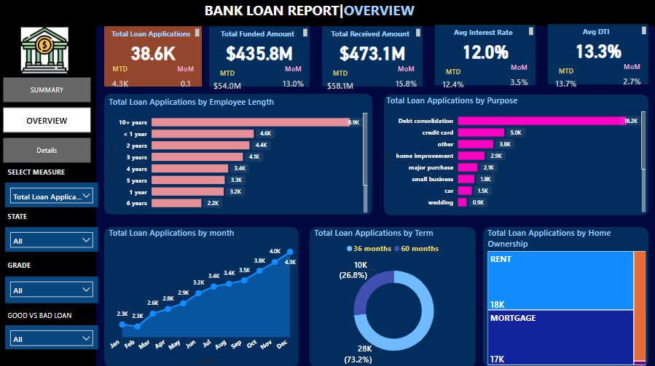
POWER BI DASHBOARD

Slide 6
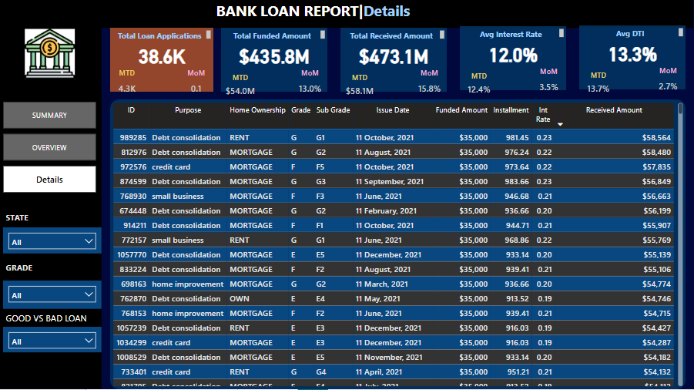
POWER BI DASHBOARD

Slide 7
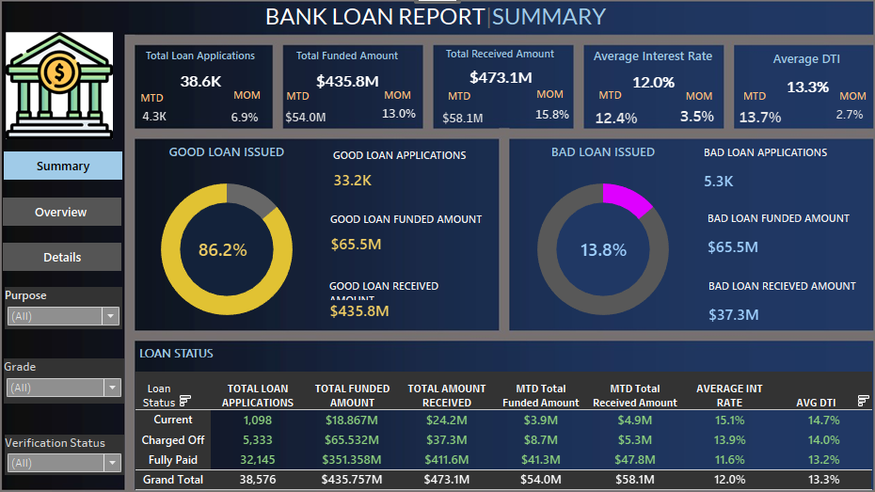
TABLEAU DASHBOARD

Slide 8
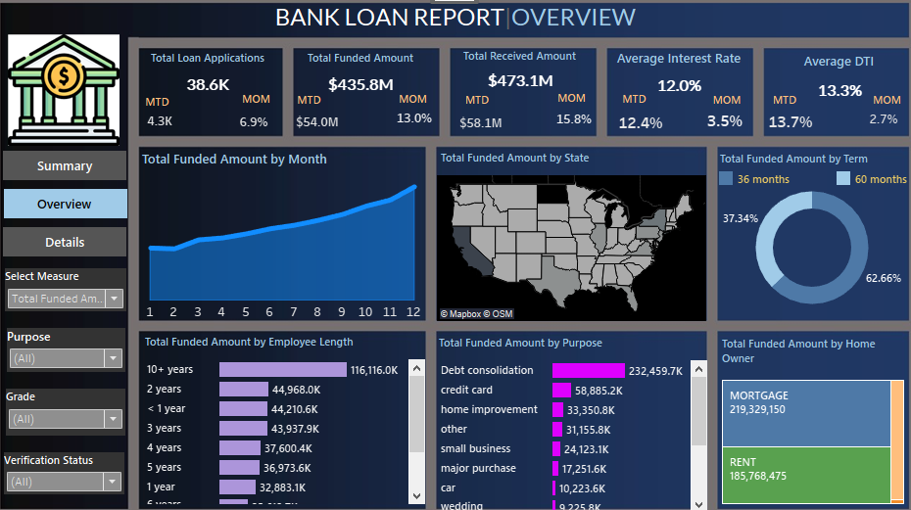
TABLEAU DASHBOARD

Slide 9
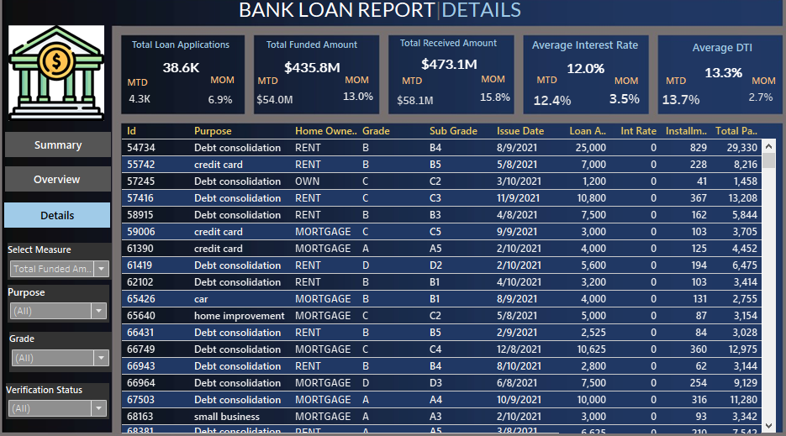
TABLEAU DASHBOARD

